Slide 1
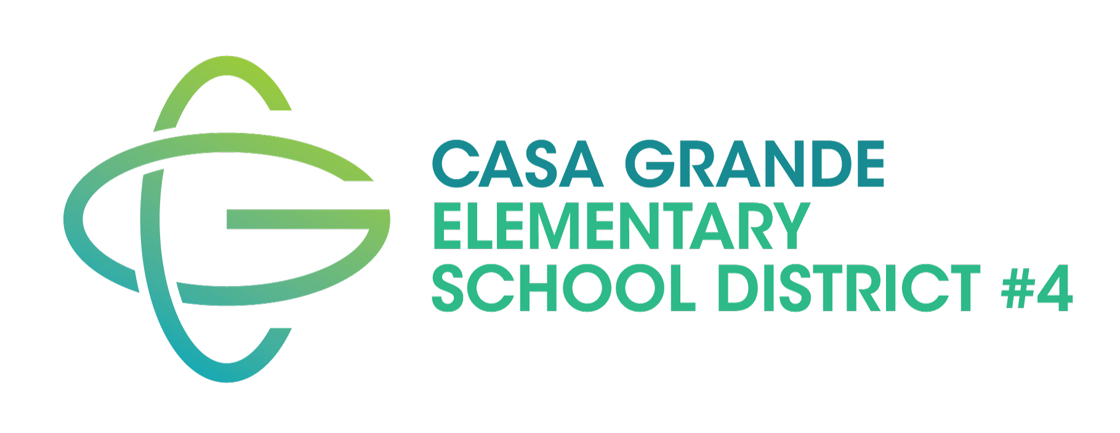
2022 M&O Budget Override Election

Slide 2
Override basics

Slide 3
An M&O override is a special election, called by the school district governing to allow voters to direct additional money to support the school system.
These funds supplement the State formula that sets funding levels per student.
Funded through local property tax.
NOT A NEW TAX.

Slide 4
While allowable up to 15%, CGESD to be fiscally responsible is requesting a 10% continuation.
This is not a new tax, it has been passed and continued on in elections successfully in 2000, 2004, 2009, 2013, and 2018.

Slide 5
Provides adequate funding to support
Maintaining class sizes within District-established guidelines
Recruit and retain highly effective teachers and staff in an ever-growing competitive market
Maintain District programs

Slide 6
Facts and figures

Slide 7
8 elementary schools
3 middle schools
1 online learning academy
1 early childhood learning center
6,600 current enrolled students
900+ employees

Slide 8
What does the current FY 23 budget look like?
Our total M&O Budget is $53,304,579
Of that amount override is $4,464,851 (8.4%)

Slide 9
Cost to homeowner
$.79 per $100 of net assessed valuation for secondary tax purposes.
Estimated Cost to an owner of a home with a limited property value of $121,460 (average value of a home in the District) would be $95 per year approximately.
Previously in 2018:
$.86 per $100 and $85 a year for a $99,347 home.

Slide 10
What happens if it doesn’t pass?
The existing override will be reduced by 1/3 in 2024/25, another 1/3 in 2025/26 and reduced to 0% in fiscal year 2026/27.

Slide 11
Questions?

